Slide 1

CIS634 – Object Oriented Software Engineering
Instructor: Weidong Xiong
Topic:-Restaurant Management System
Presented by:
Bhavana Tedlapalli
Patel Riyaben
Sravan kumar Singupuram
Calvin Raj Namburi

Slide 2
Introduction
This is project is mainly about understanding real time objectives of the Object-Oriented Software Engineering.
We have developed a Restaurant Management system.
We have followed Agile Methodology for building this project.

Slide 3
Project Requirements
The project will then use architectural design to generate a broad vision for the evolving system. it moves on to system modeling, which involves creating design models to comprehend the limitations and characteristics of the system. Finally, effective user interface design methods are covered.
We have used HTML, CSS, JS, Bootstrap, Python languages for frontend. As well as flask for fronted framework.
For backend management we have used MySQL.
The IDE we used is visual studio code.
For Mac we use Docker, MYSQLWorkbech

Slide 4
Requirements Profile
The web application will have two interfaces.
Each for restaurant manager and customer.
Customer's interface will consist of a scrollable menu listing available items, and their price. When the customer selects some dishes and place the order, it will be stored in "cart".
Whenever there is a party order customers can add/modify/delete accordingly to their requirement. And they can add/modify/delete number of people. And they can specify their instructions and add up to their spice levels.
Manager's interface will be such that he is notified of the pending order, and he is able to assign it to one the available queues of chefs who are then able to see the new order in their screens or on a central display in kitchen.

Slide 5
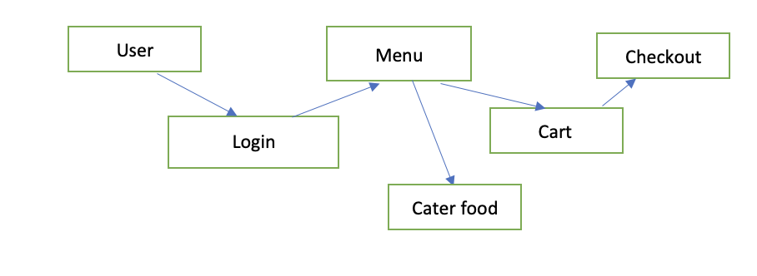
Requirements Relations

Slide 6
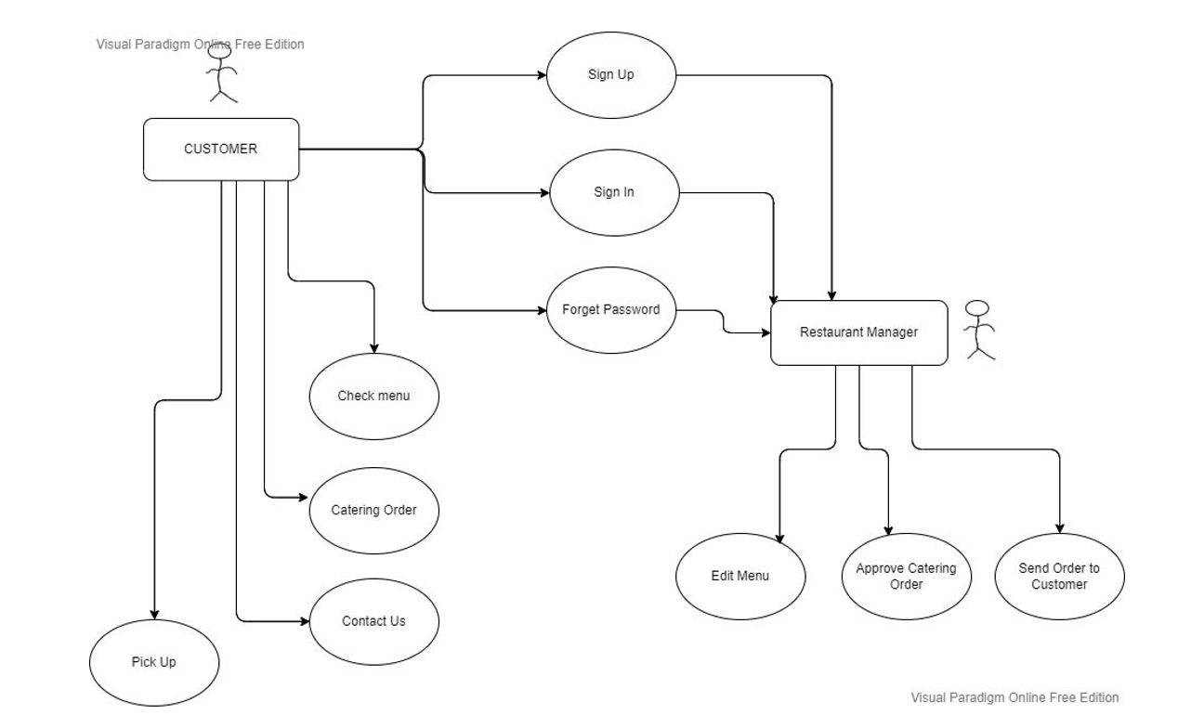
Use case diagram

Slide 7


Software Design system
MVC (model view controller) architecture was used to develop restaurant system.
As a software design pattern for developing web applications MVC is popular.
MVC architecture divides web application into three parts. All those parts are interconnected. It is fully capable to support rapid web application development and dynamic interactivity with the database.

Slide 8
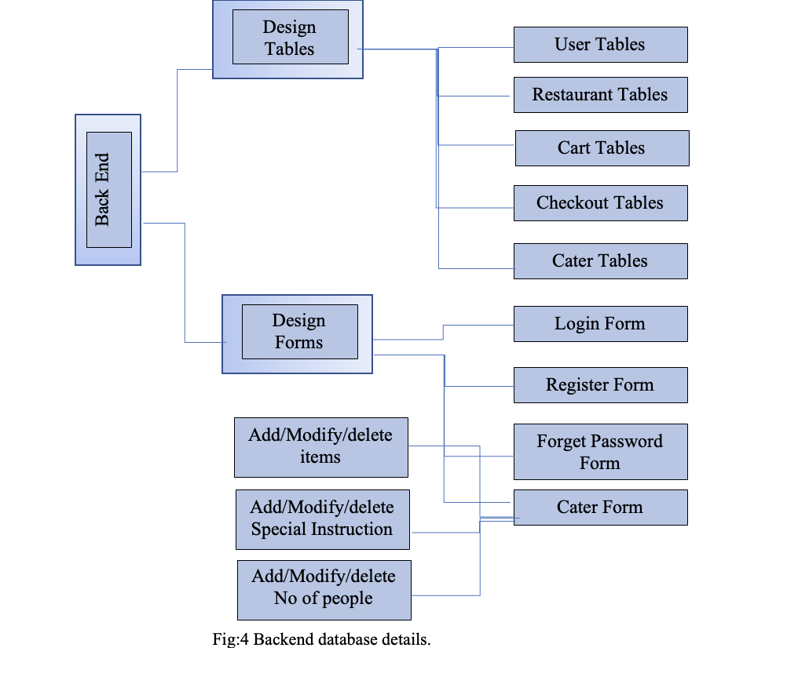
Front end:
Visual studio
GUI design
Database modelling
Design control
Back end:
Design tables
Design forms

Slide 9
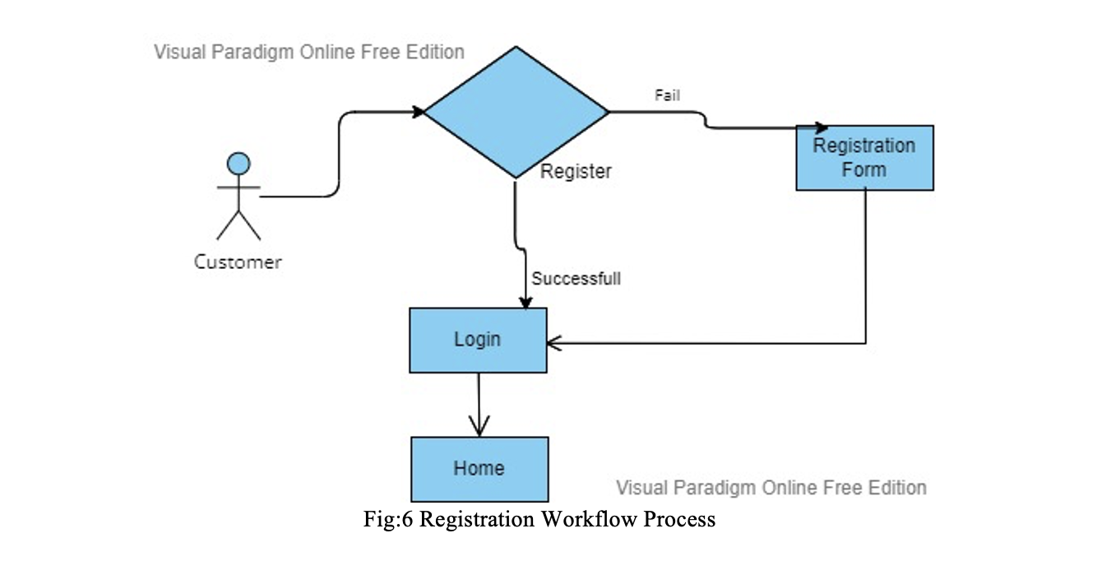
Workflow Process
Registration WorkFlow Process

Slide 10
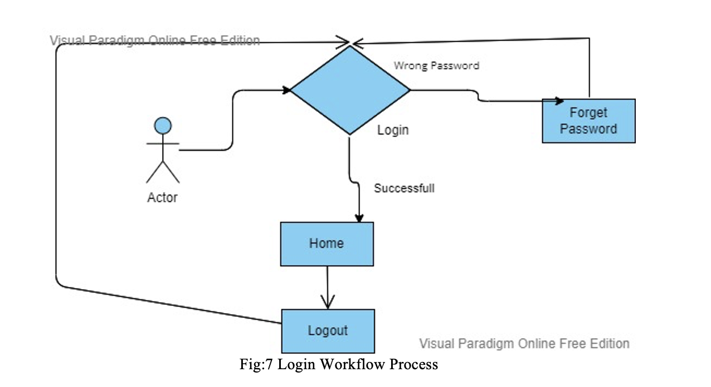
Login Workflow Process

Slide 11


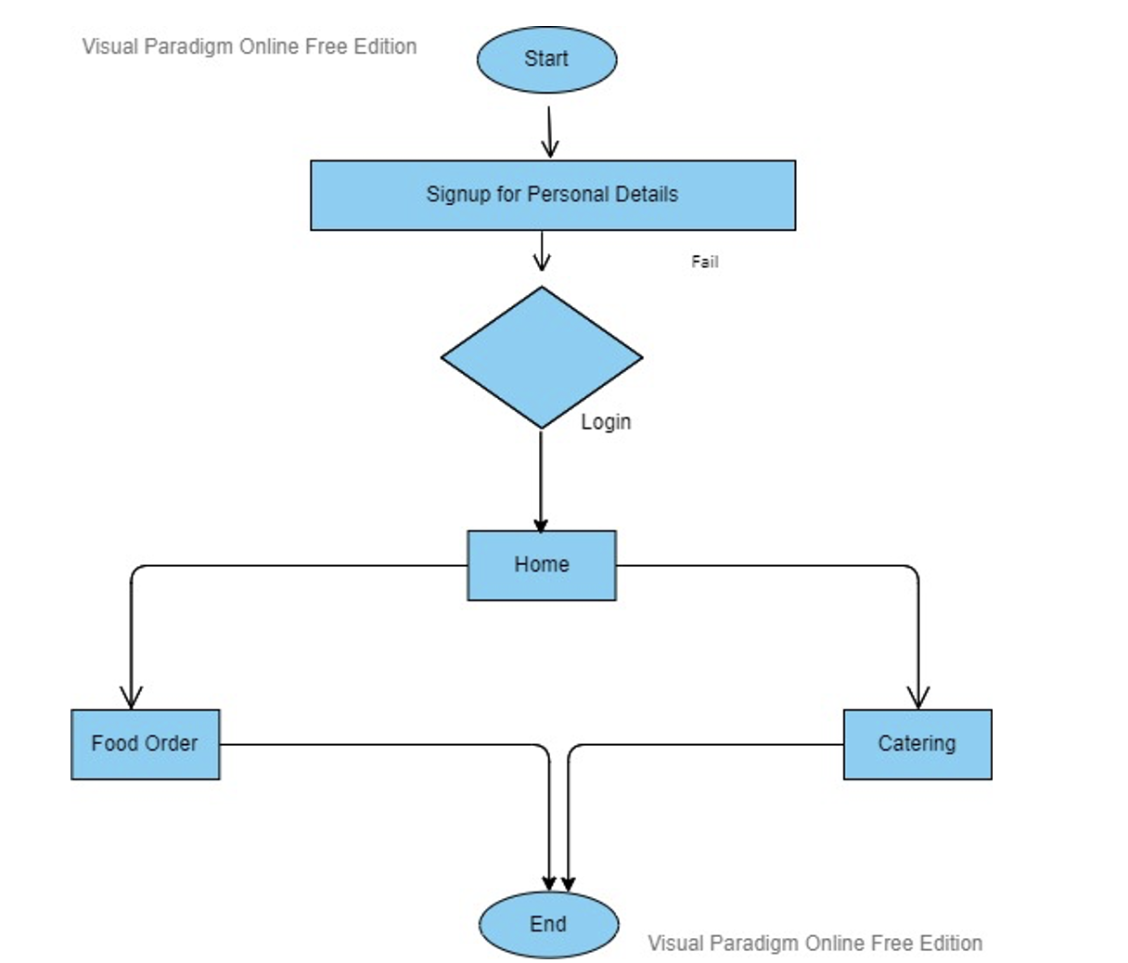
Admin Workflow Process

Slide 12
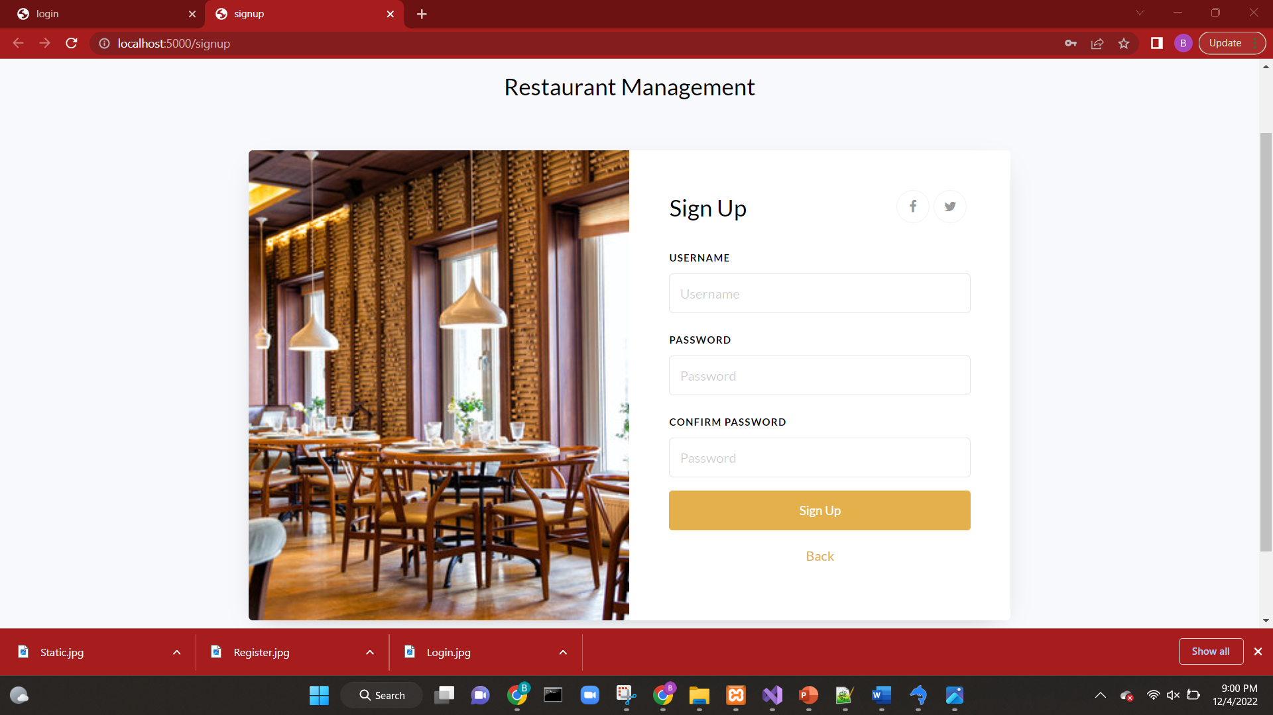
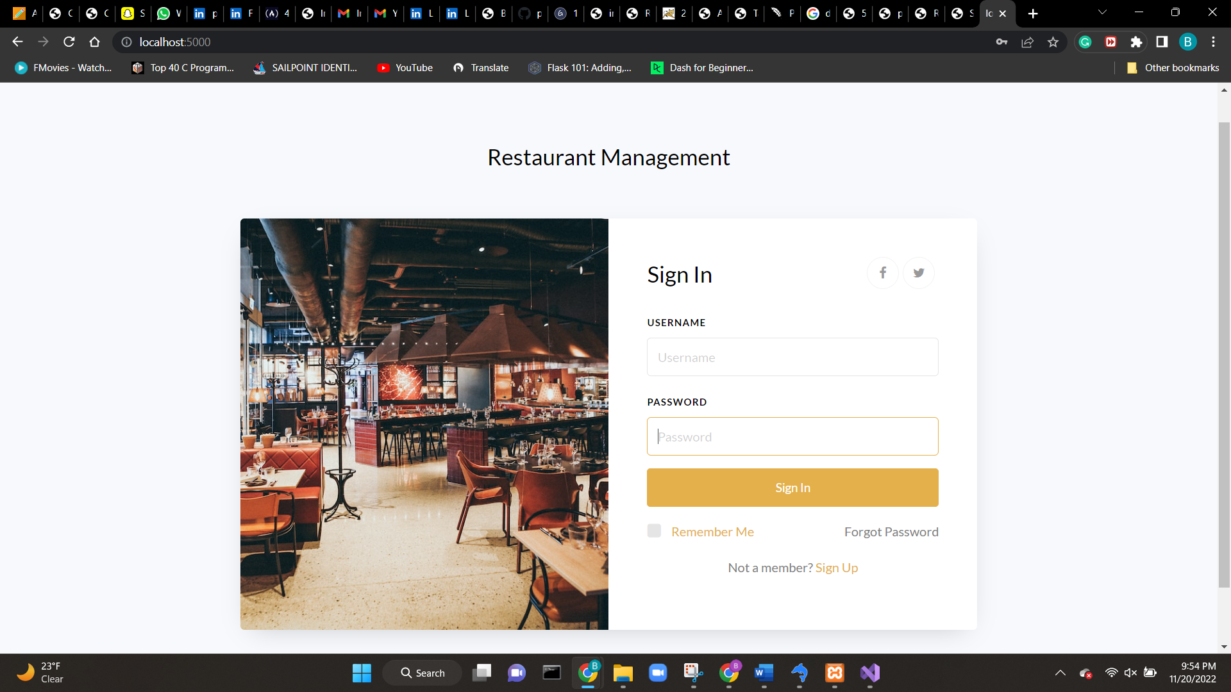
Sign Up/In Page

Slide 13
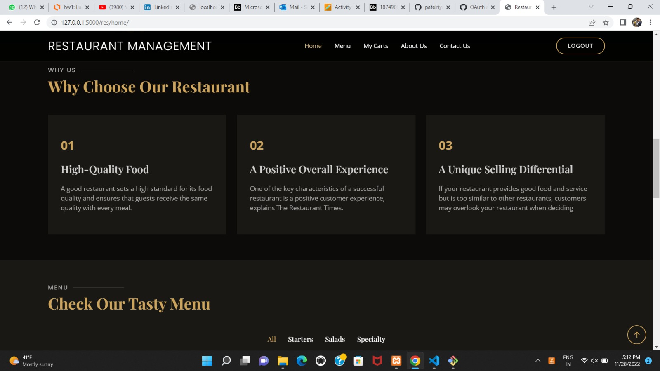
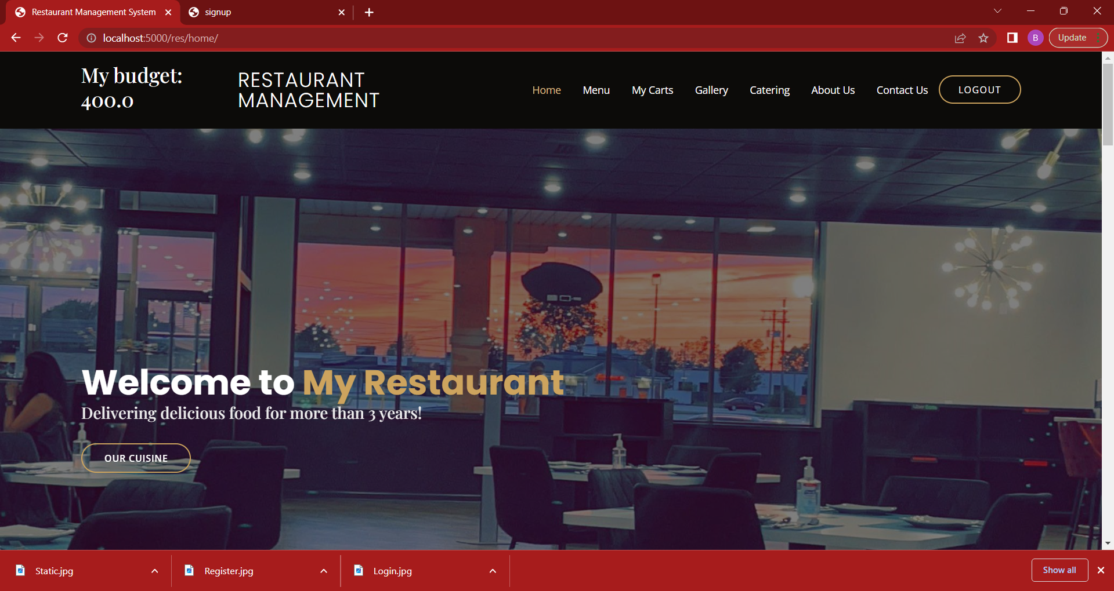
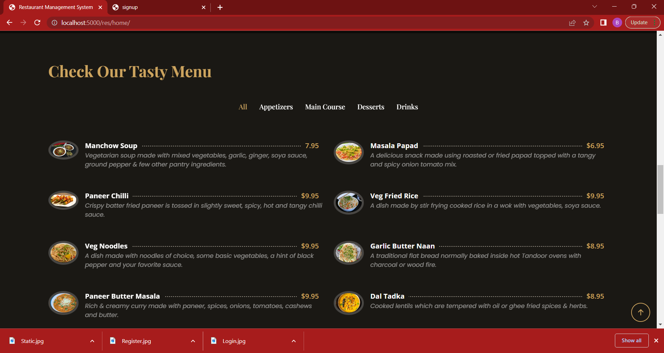
Home Page

Slide 14
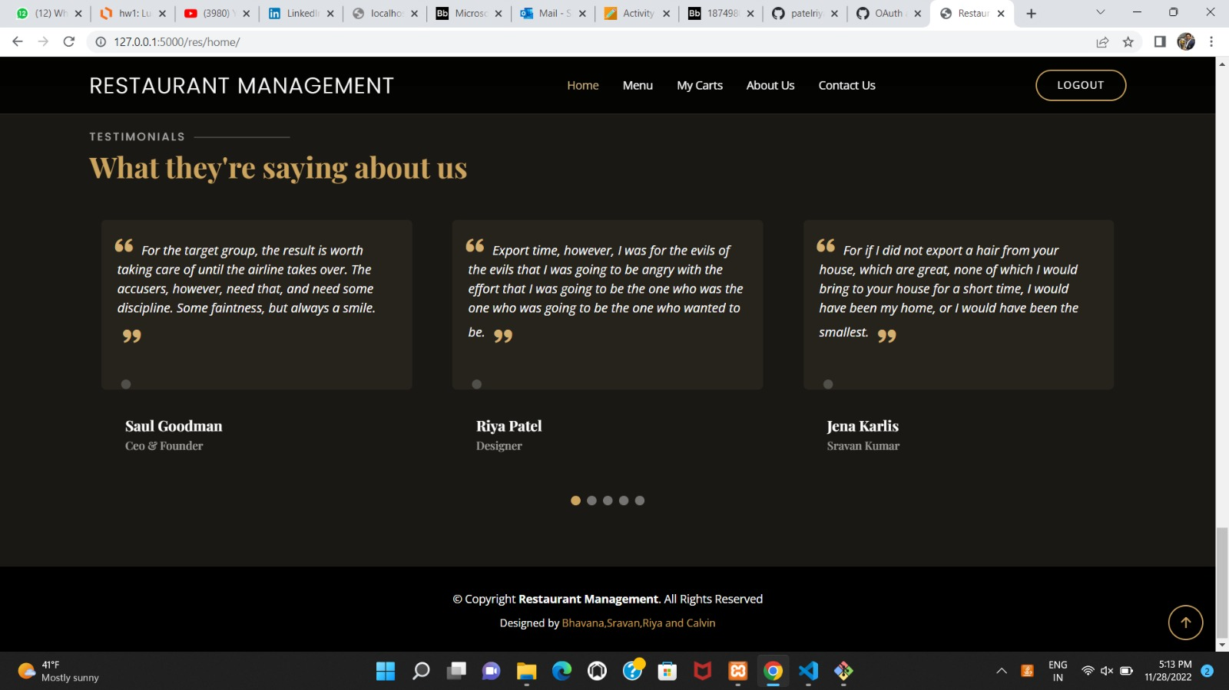
Testimonials

Slide 15
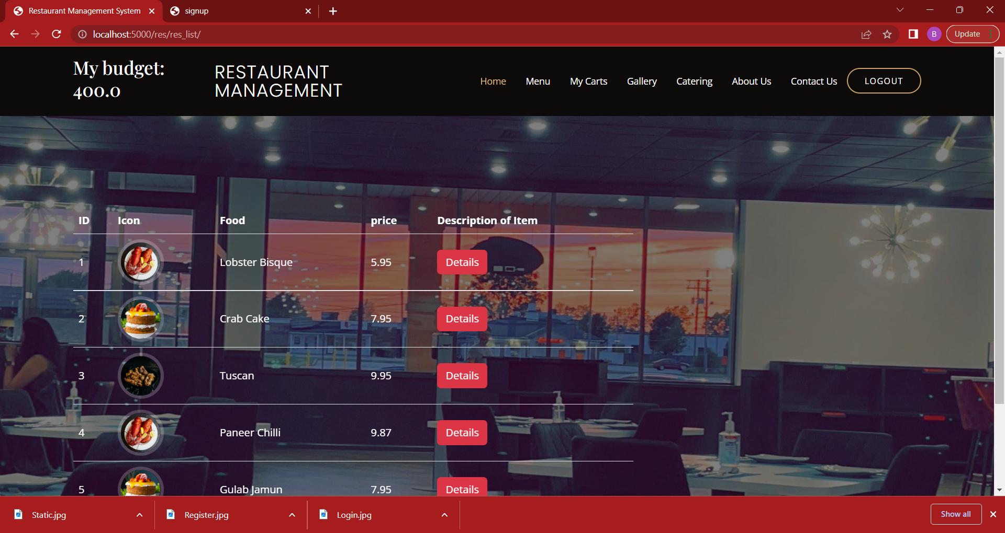
Menu Page

Slide 16
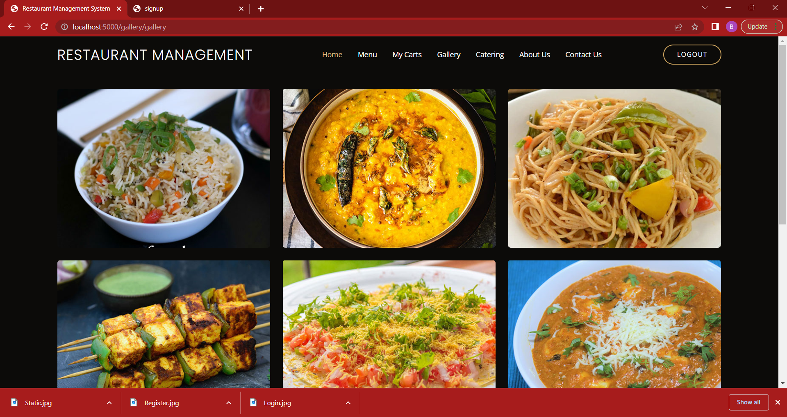
Gallery Page

Slide 17
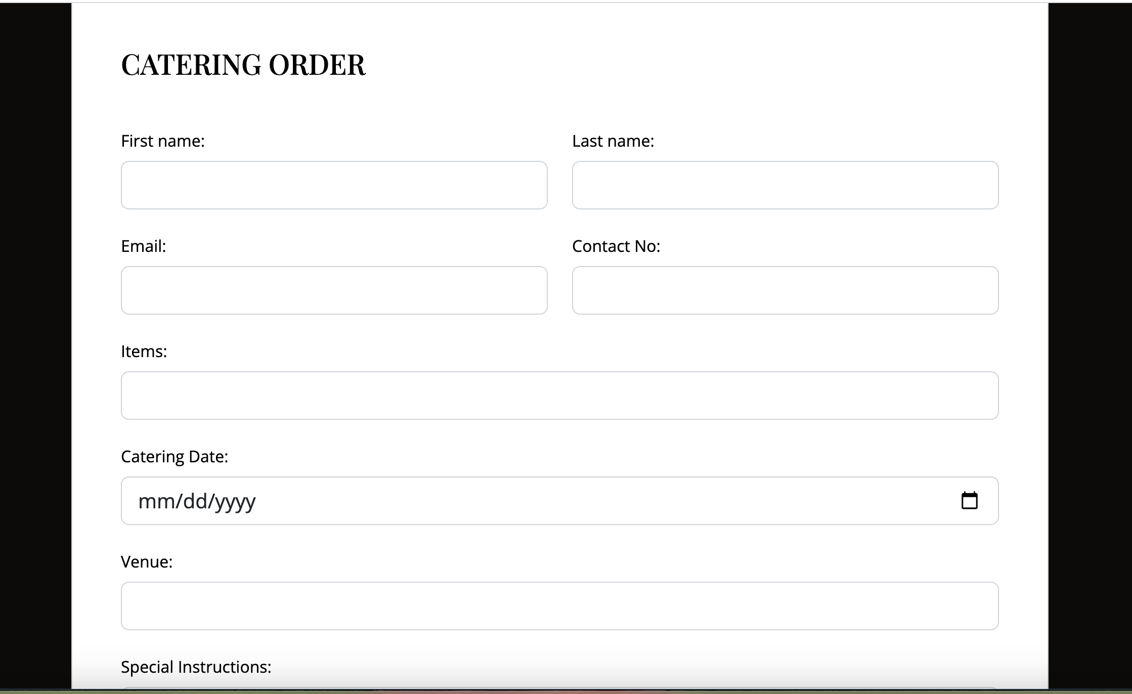
Catering Page

Slide 18
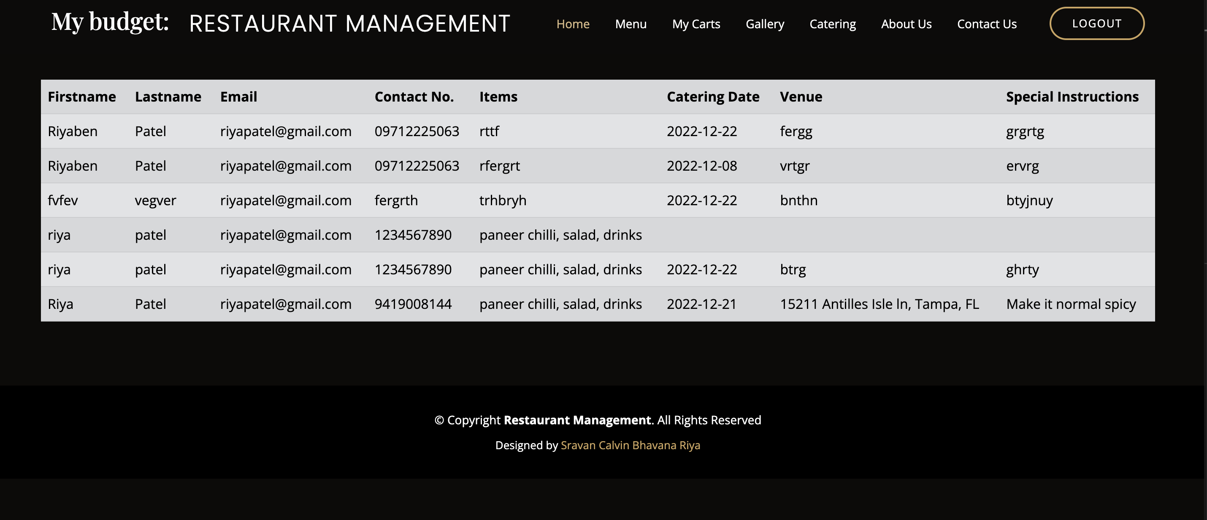
Catering placed

Slide 19
Testing
The test environment for tools is before running the python shell and compiling the app.py, we need to make sure whether the MySQL database is up and running. And then we can compile the app.py and wait for the localhost:5000 and the webpage starts running. There we can login, signup and then go deep into the website to see the Menu, testimonials and adding items to cart, etc.
Coming to Hardware we need to make sure MySQL and python are installed in the admin’s laptop and make sure the internet connection is stable.

Slide 21
Future Enhancement
We plan to do checkout with online card Payment
Add more functionality in catering. Like No of people and count food like that way Update order within 1 day.
Admin GUI.
Implementation document is attached here.
Source code is presented in the zip file.

Slide 22
Thank You

